Slide 1
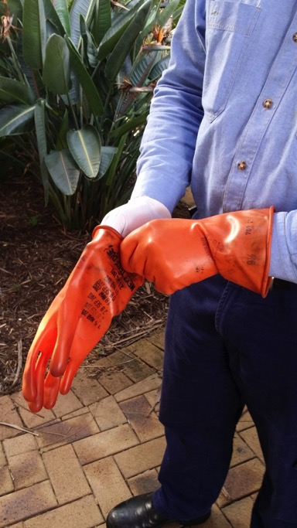
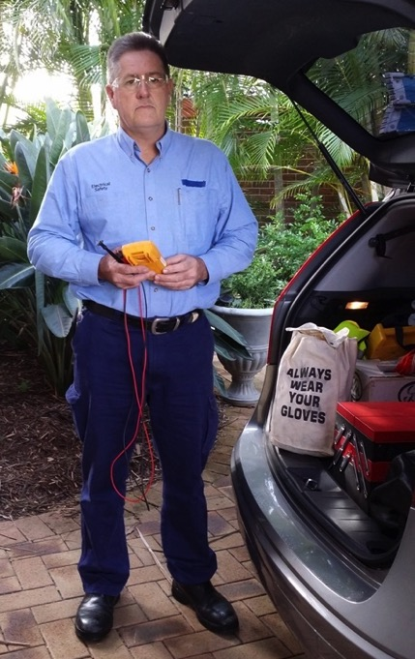
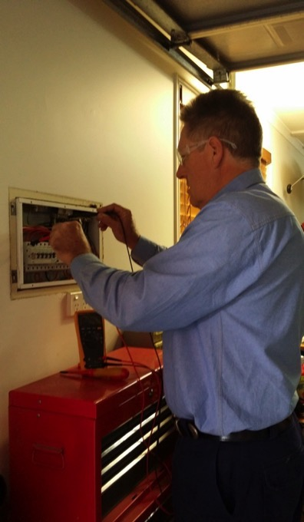
Personal protective equipment: Electricians

Slide 2
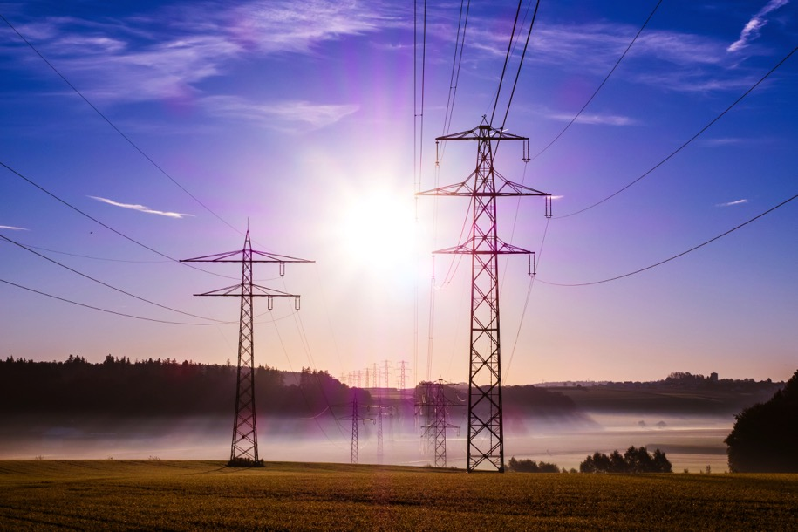
Electricity is dangerous. Very dangerous.
There is a range of jobs that work with electricity and electrical appliances. People in those jobs follow strict safety protocols with their clothing, equipment and behaviour to stay safe.

Slide 3
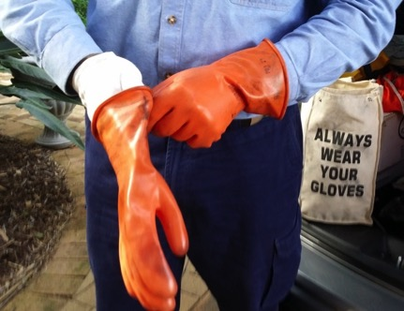
When electricians are working in residential situations, for example, in a household, they disconnect the electricity from the power source before they start working. A test instrument is then used to prove there is no electricity left in the circuits or electrical appliances.
While testing to ensure the power is off, electricians should wear a minimum of:
safety boots
long-sleeved cotton shirt
safety glasses
insulated gloves (if a risk assessment deems necessary).

Slide 4
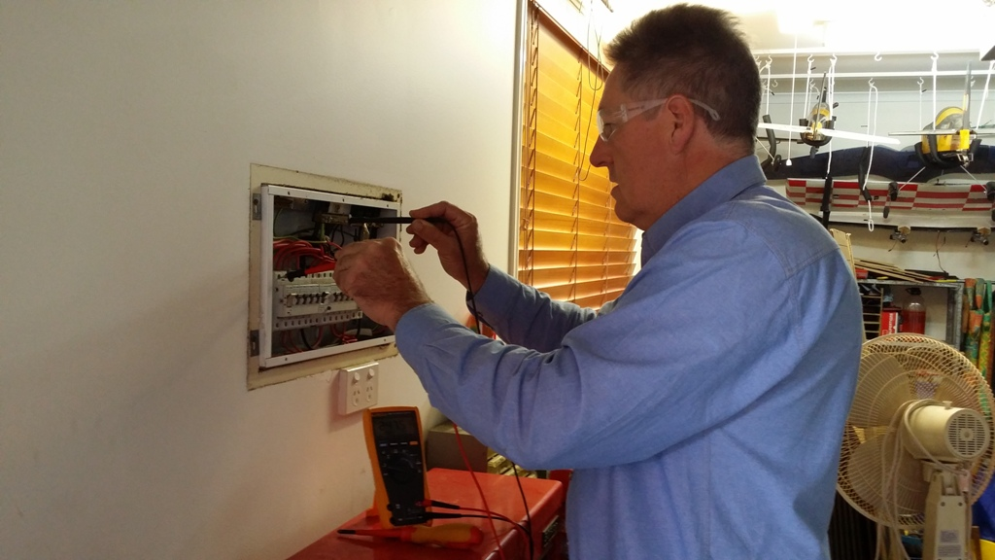
When working on household repairs, electricians should wear a minimum of:
safety boots
long-sleeved cotton shirt
safety glasses.

Slide 5
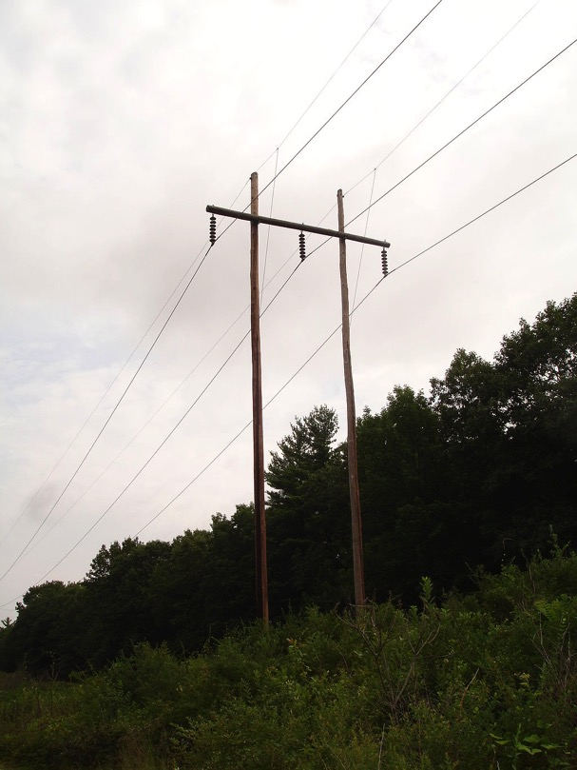
Have you ever noticed power lines along the street?
Electricity is transferred from the power stations where it is generated along big metal wires either above ground through power lines or below ground through cables to houses and businesses.

Slide 6
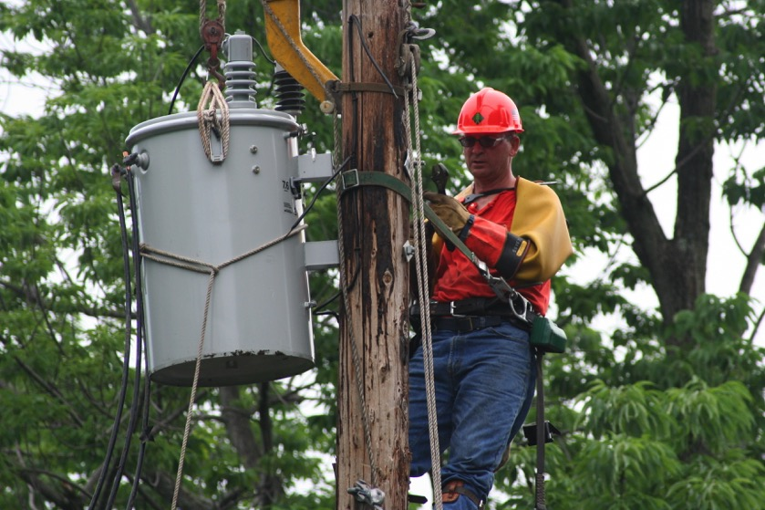
Electricity can’t be disconnected from power lines when electricians need to work on them. These electricians are called live linesmen and they need to wear more safety clothing than electricians working on houses where the electricity has been disconnected.
Live linesmen need to wear:
long-sleeved cotton shirt and long pants (or cotton overalls)
safety boots
safety glasses
hard hat
safety harness
three pairs of gloves (one cotton inner glove, one insulating rubber and one leather to protect the insulating rubber glove).

Slide 7

Hard hat
Safety glasses
Long-sleeved shirt
Safety harness
Extra-thick-rubber insulated gloves
Long pants
Notes:
This electrician is wearing a hard hat, glasses, a safety harness, long pants and long-sleeved shirt and extra-thick-rubber insulated gloves.

Slide 8
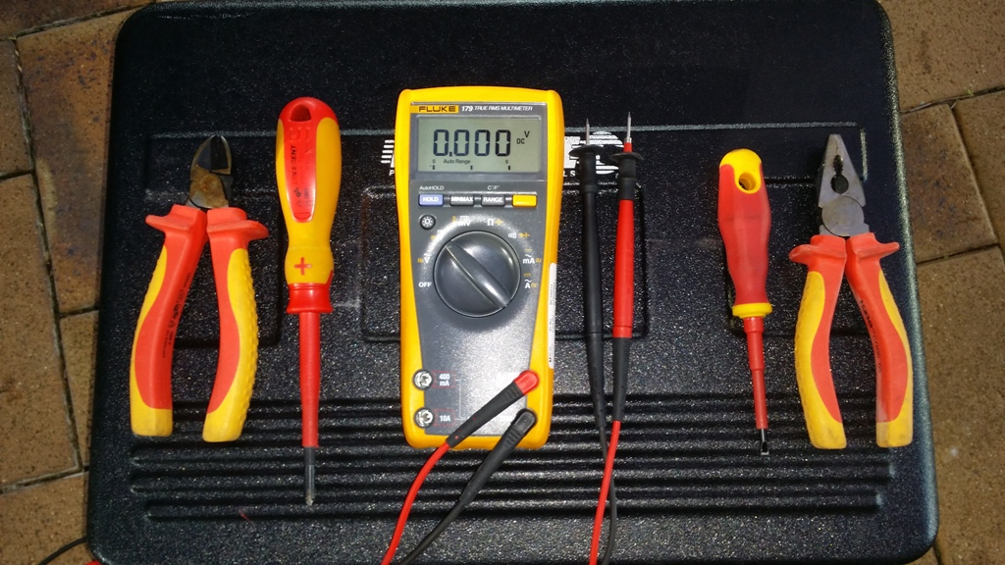
Electricians use a range of tools and equipment to help do their job safely. Many of the hand-held tools are encased in thick rubber or plastic and insulated to 1000 volts.

Slide 9
Attributions
Slide 2: http://pixabay.com/en/power-poles-upper-lines-power-lines-503935/
Slide 5: http://commons.wikimedia.org/wiki/File:Wood_Pole_Structure.JPG
Slides 6 & 7: http://commons.wikimedia.org/wiki/File:Lineman_changing_transformer.jpg
Persons appearing in this resource do so with consent.

